Slide 1
WETA DRTV Analysis
Jan – Feb 2017 Test Campaign
May 2017 review

Slide 2
Summary
Pilot provided clear results: DRTV approach was ineffective for WETA. With round-the-clock spots on TV26, WETA HD and WETA UK (outside of primetime) + 2 weeks of primetime spots on WETA UK, we raised $27k in direct contributions to the campaign vs. our modest pilot goal of $109k. Some revenue from the main donate button was likely due to the spots as well, but not enough. In addition, almost 50% of donations came from current active members. The goal of the campaign had been primarily to bring in new or lapsed reactivated donors.

Slide 3
Topline Results and Other Tidbits
Unless Noted, all analysis omits Main Donate gifts.
Excluding Main Donate
156 DRTV Donors - 12 Month Value of Gifts - $26,553
Including Main Donate
Main Donate - 12 Month Value of Gifts - 712 Donors - $96,501
Highest Response Channel - (45%) from dedicated online donation pages
Highest Response Donor Tenure – 75 (48%) Current WETA Members

Slide 4
Topline Results and Other Tidbits
Only 45% of Thank You Gift eligible donations opted for the Fleece
WETA UK provides the most valuable donors
Most valuable daypart is afternoon (12 noon- 4 pm)
Current and Lapsed Members upgraded their 12 month value by $11
Less than 4% of Donors gave via EFT
Only Two Audience Service Comments on Campaign
Two donors formerly giving through workplace giving made sustaining gifts via the Main Donate Page

Slide 5
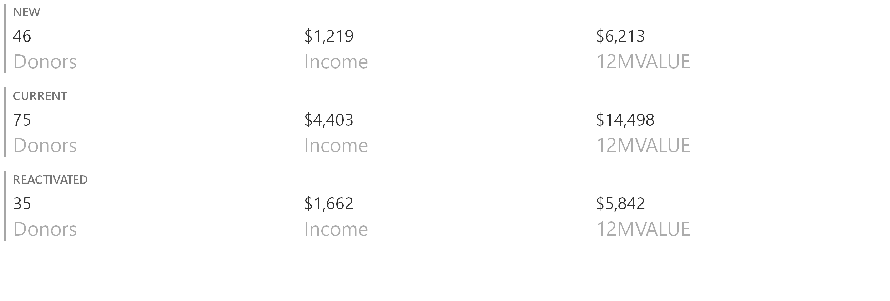
DRTV Donors
FY 2017
Without Main Donate Form Gifts

Slide 6
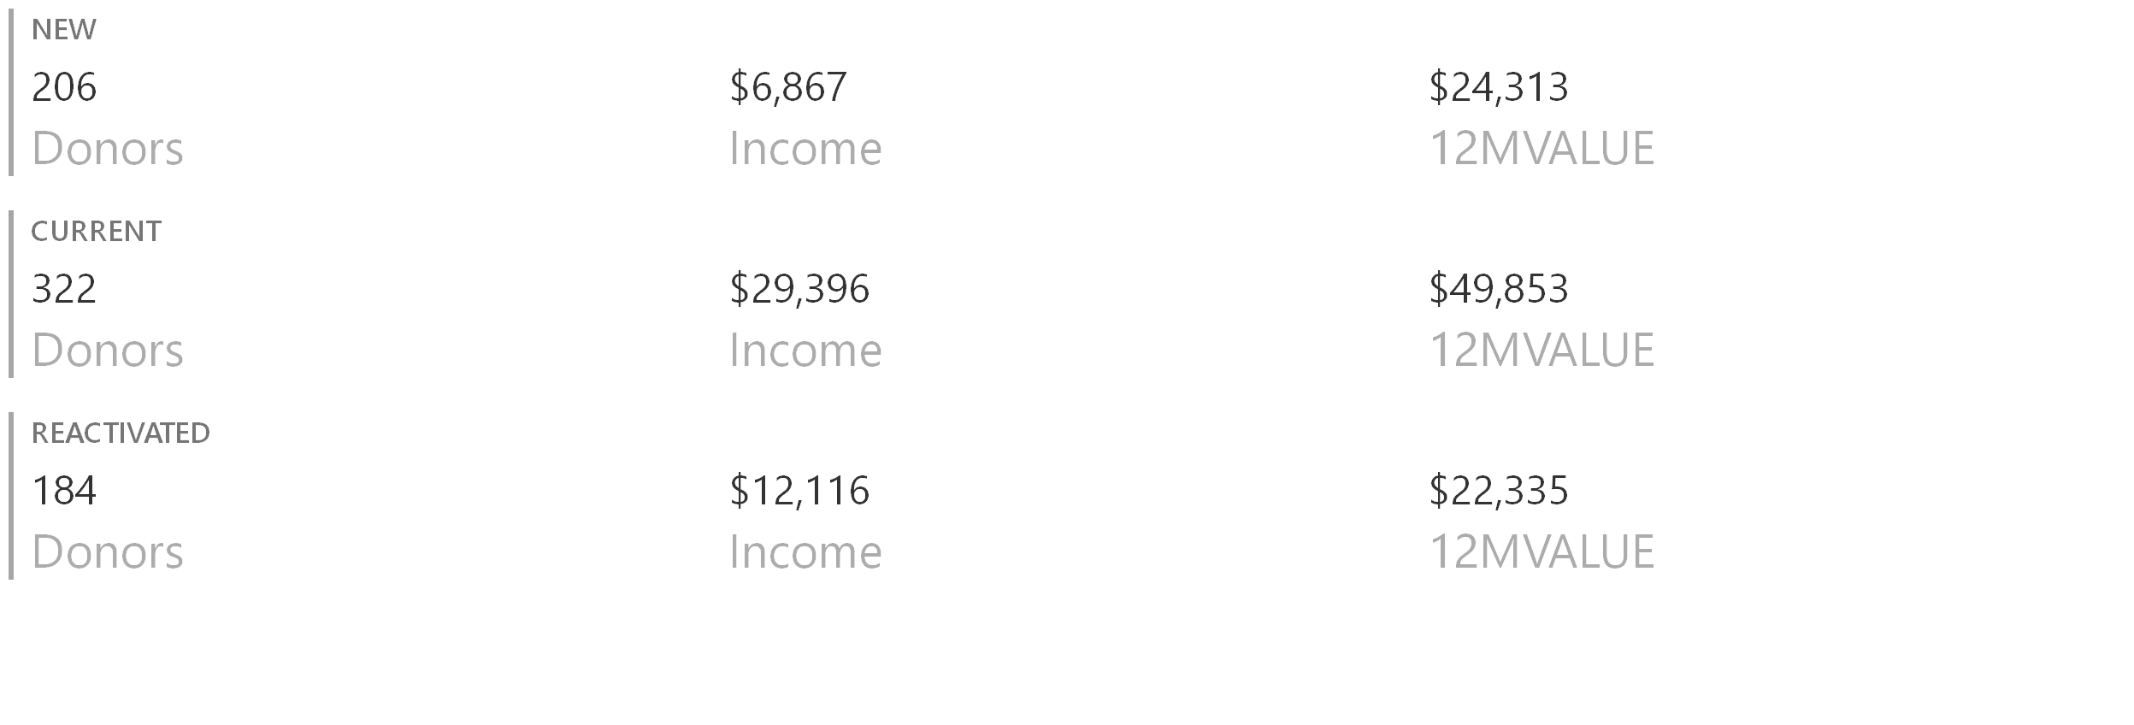
DRTV Donors
FY 2017
Summary with Gifts to Main Donate Form

Slide 7
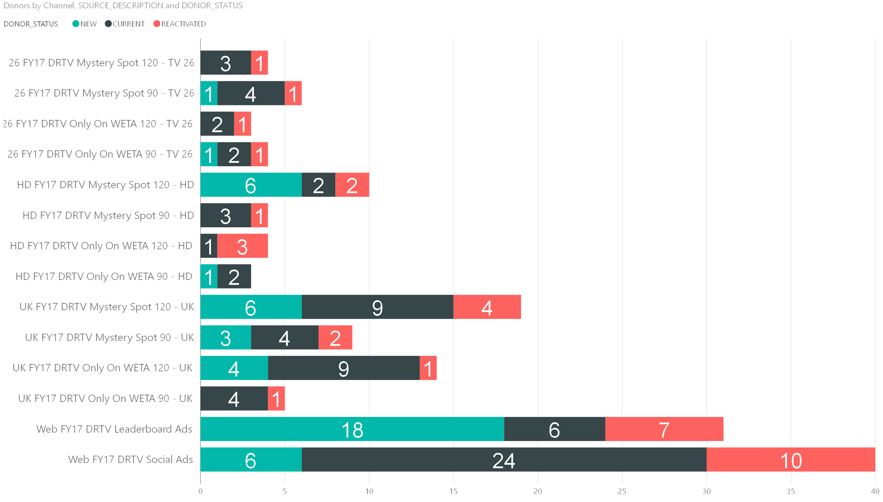
Donors by Channel and Spot Majority of Gifts via Web / Highest % of New Members from Leaderboard (11.5% of all Gifts, 39% of New Donors)
17 via TV26
21 via TVHD
47 via UK
71 via Web

Slide 8
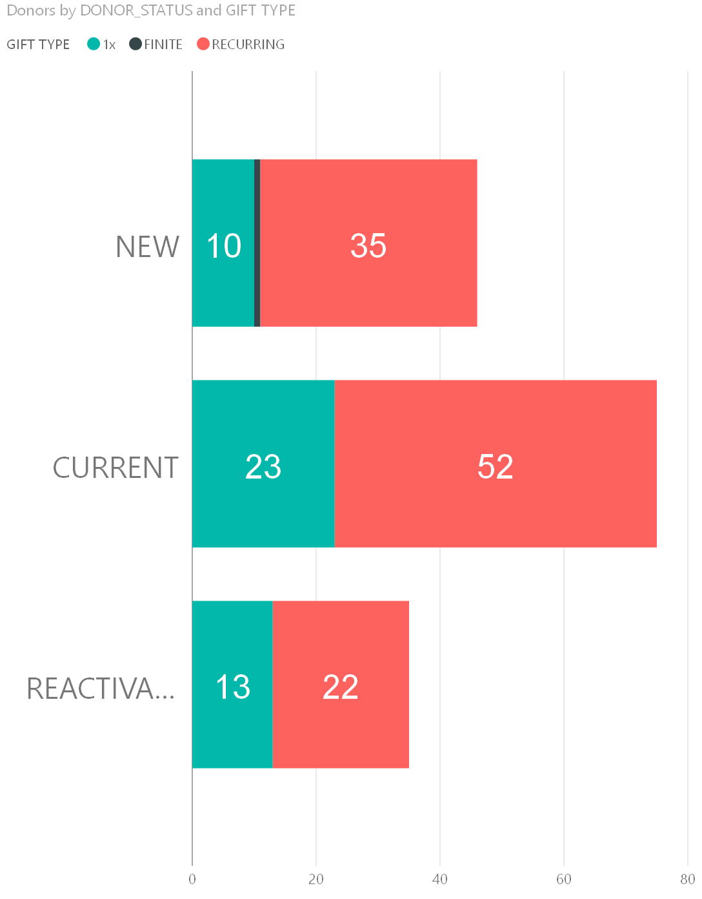
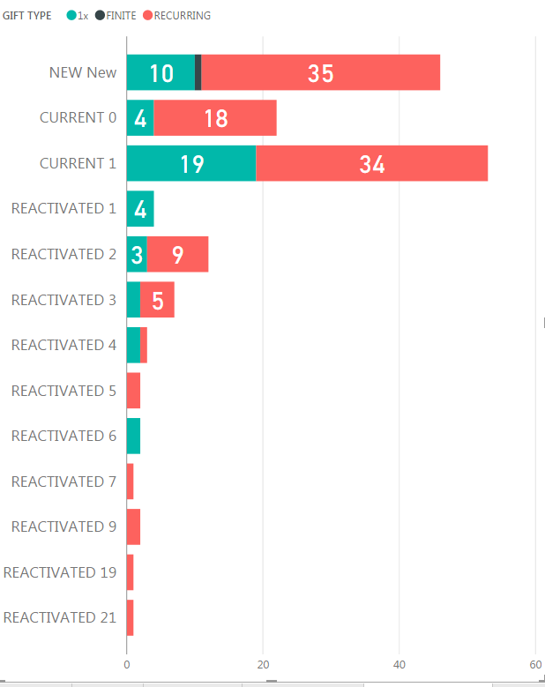
Majority of DRTV donors are current WETA members 46 New, 75 Current,35 Reactivated (most were 1 yr – 6 yrs lapsed)
Numbers = Calendar years prior to gift

Slide 9
The majority of current or lapsed donors were previous DRF donors prior to this campaign

Slide 10
UK Responders provide the Highest 12 Month Value and Higher mix of sustainers compared to other channels

Slide 11
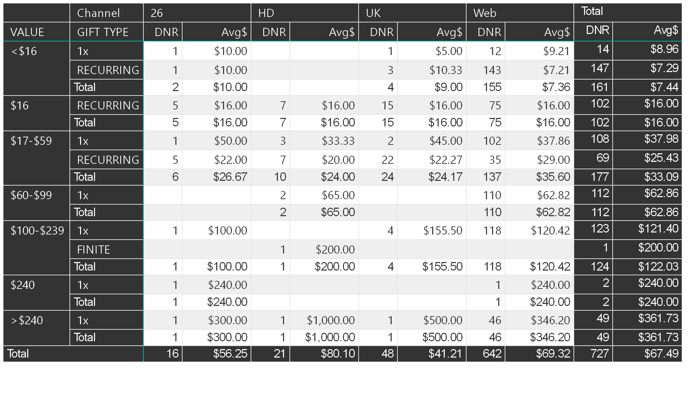
Gift Array – Inclusive of Main Donate Page Only two $240 gifts but 49 at higher amounts 20% of 1x gifts at Passport level
$1K gift from existing LC

Slide 12
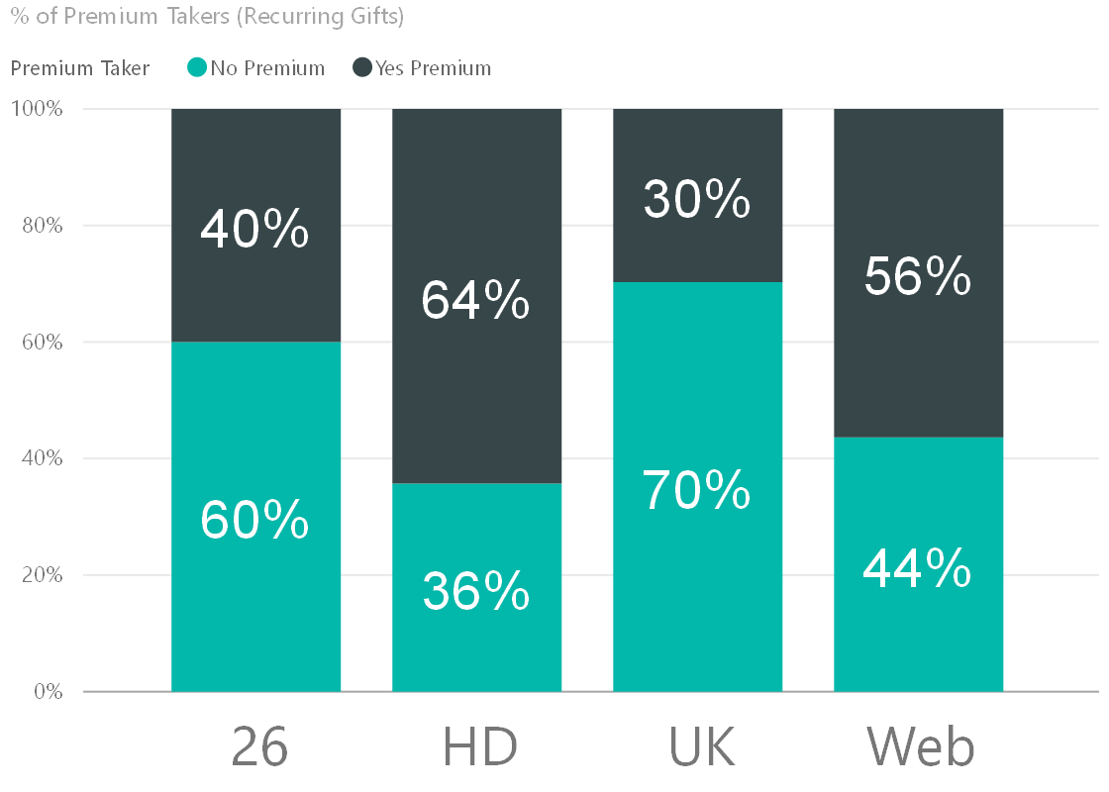
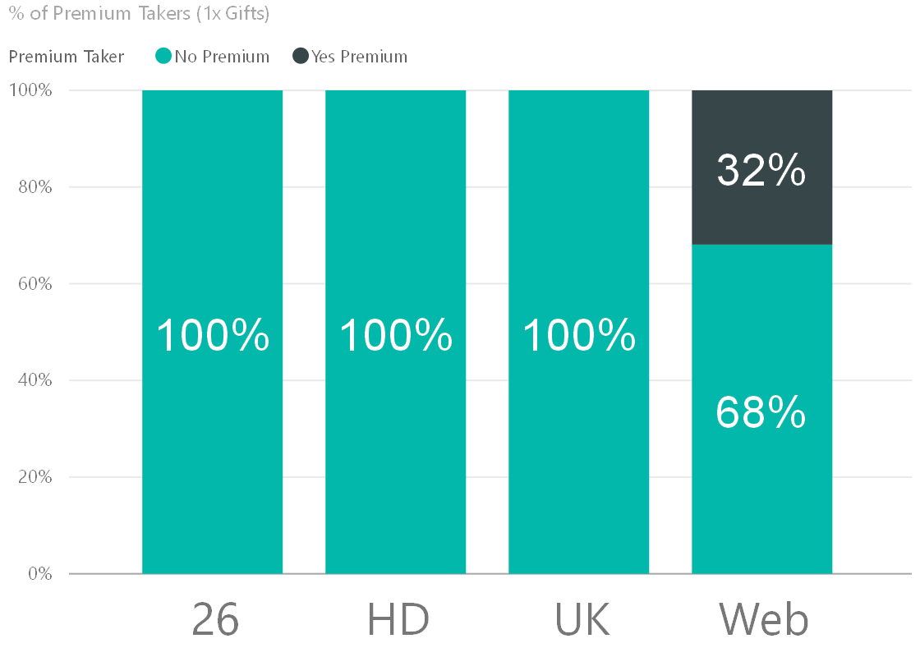
Premium Takers – 45% of Eligible Donors Requested a Thank you Gift (inclusive of Main Donate)

Slide 13
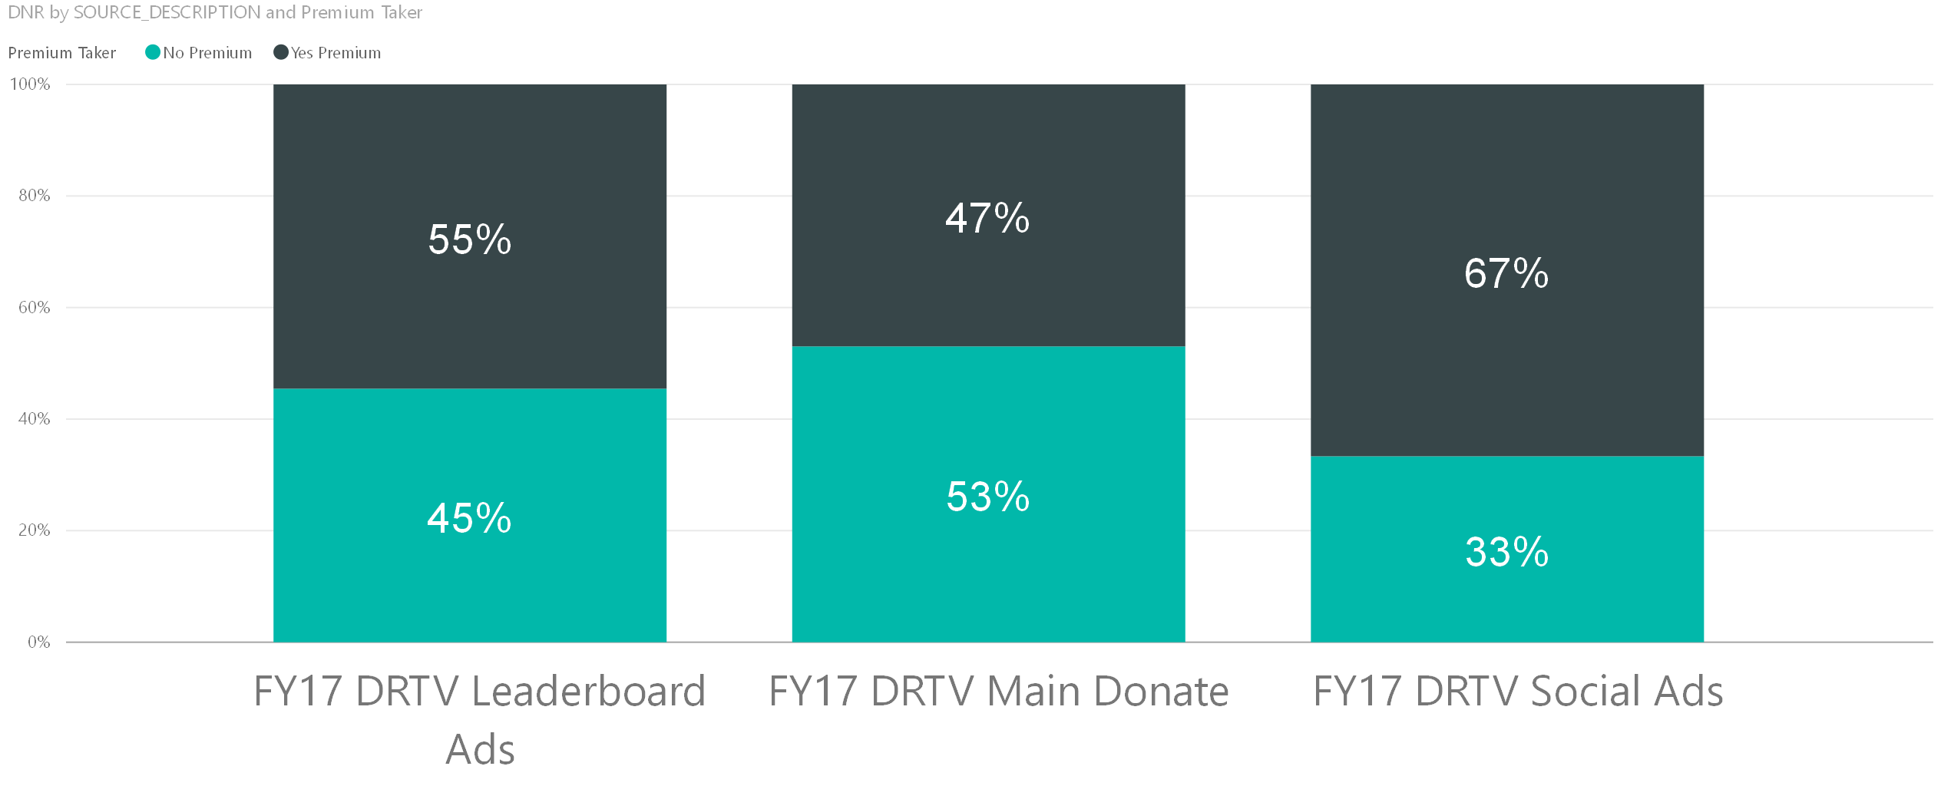
Premium Takers Web Only Highest % of Thank You Gift takers were from the social ads

Slide 14
Daypart Comparison by Channel Majority of Gifts in Afternoon Daypart
Web Gifts continue after 4 pm while other gifts drop – not surprising as spots were not airing
Higher Value donors from UK throughout daytime dayparts

Slide 15
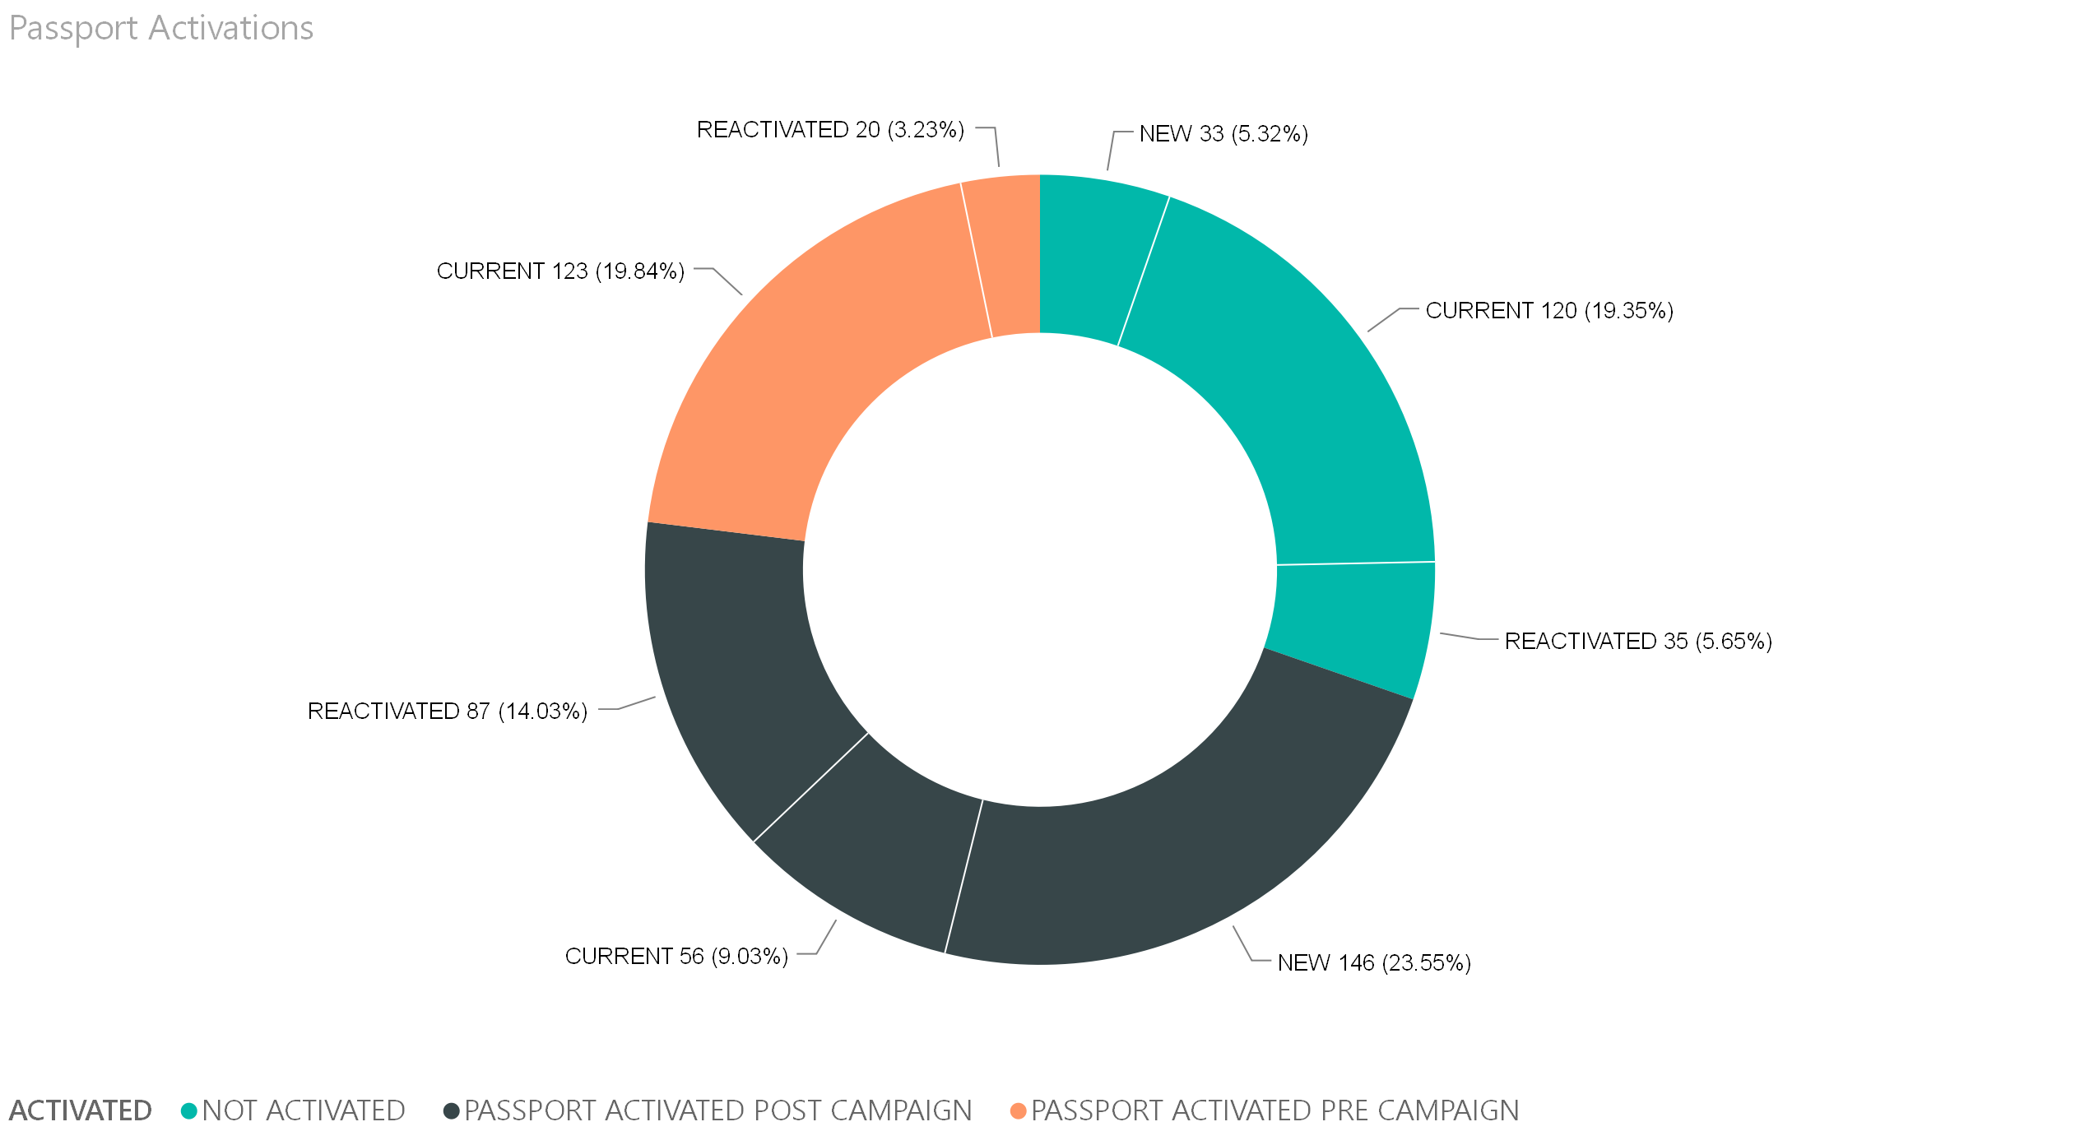
Passport Activations inclusive of Main Donate Page 46% of Donors Activated Passport*
*Passport qualifying gifts only

Slide 16
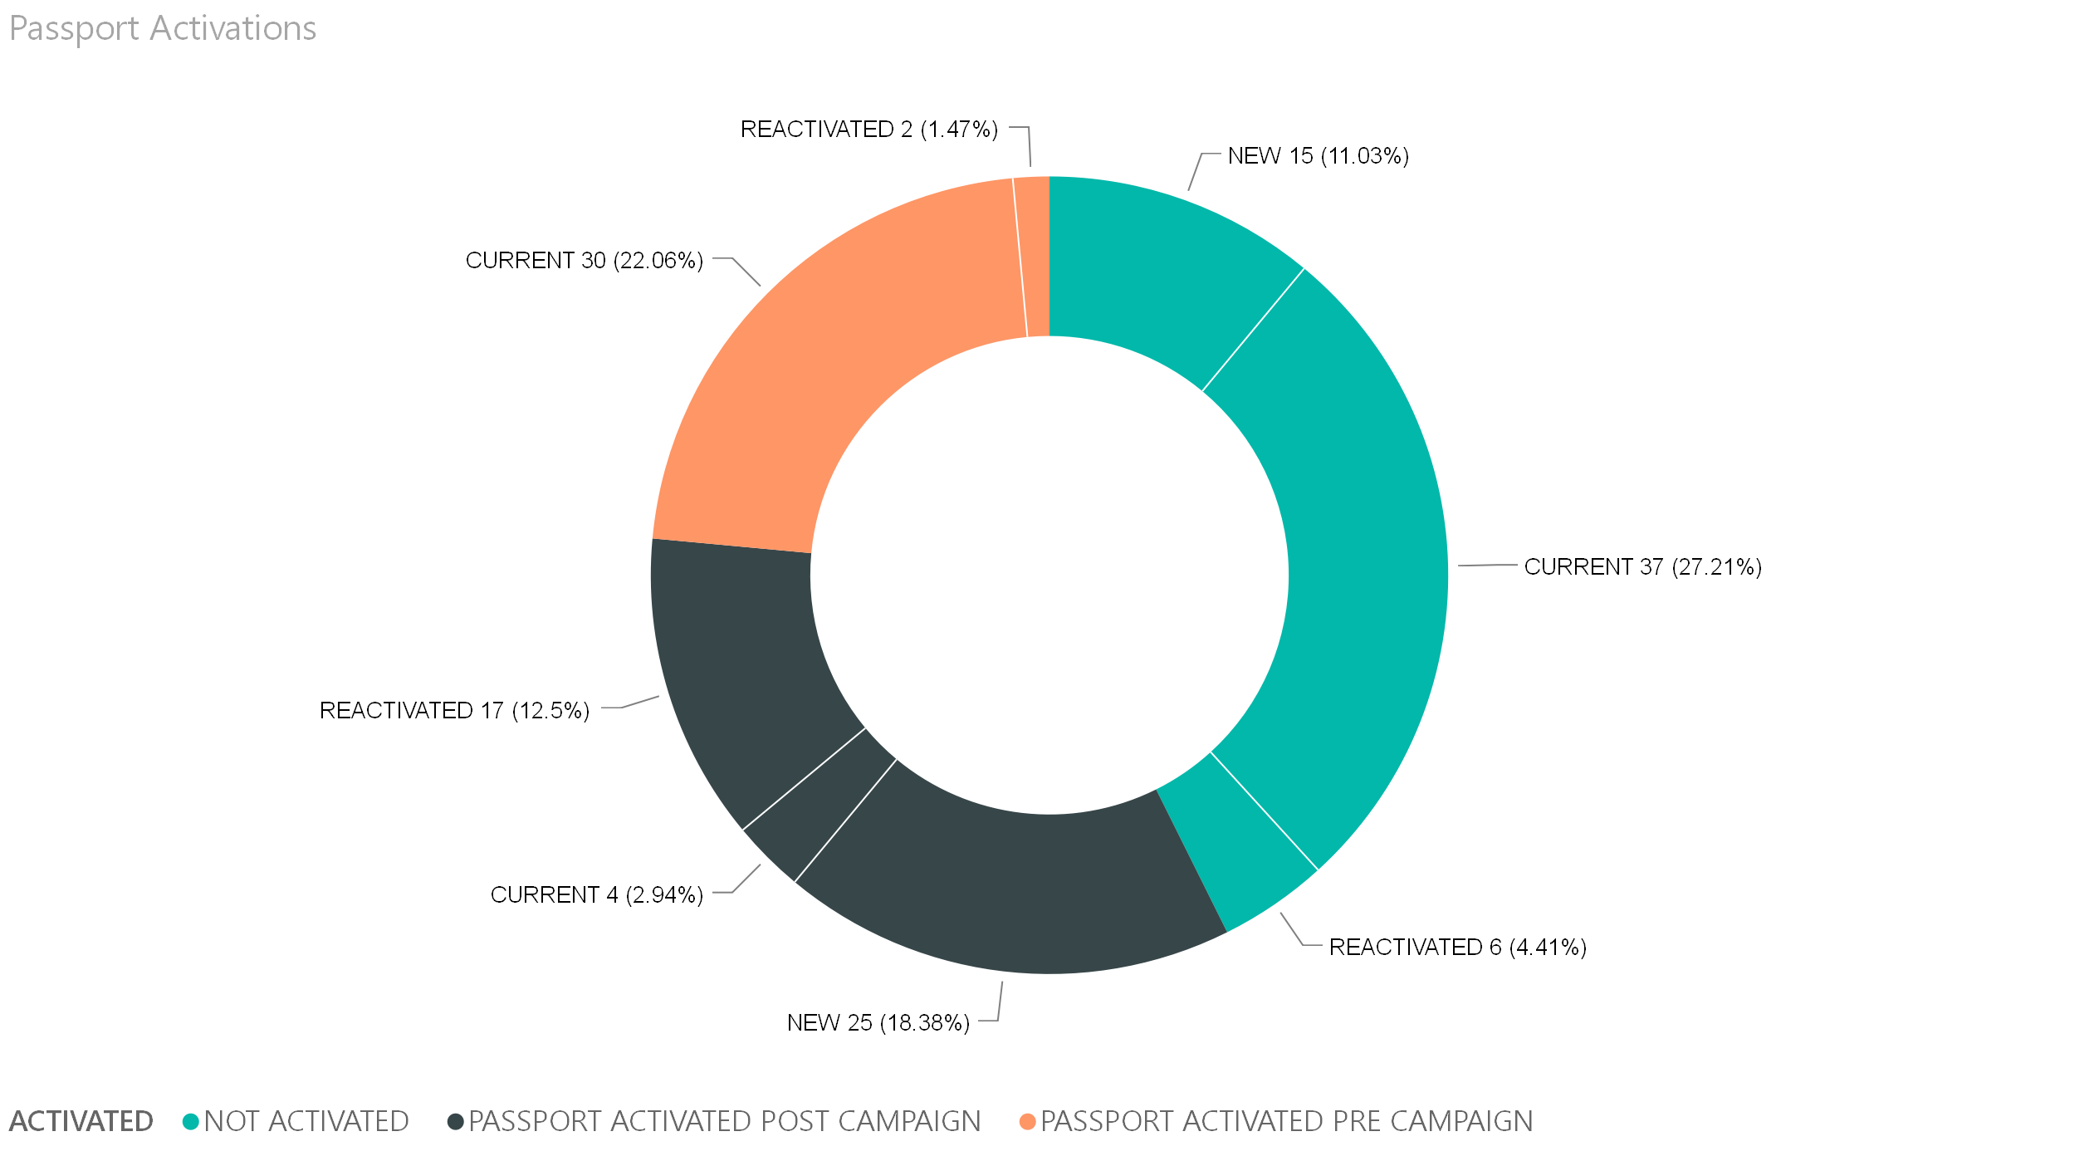
Passport Activations Without Main Donate Page Only 33.5% of Donors Activated Passport*
*Passport qualifying gifts only

Slide 17
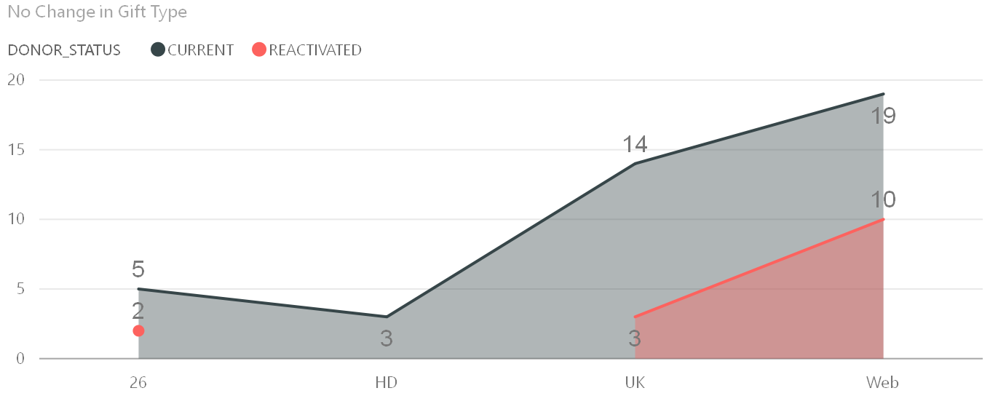
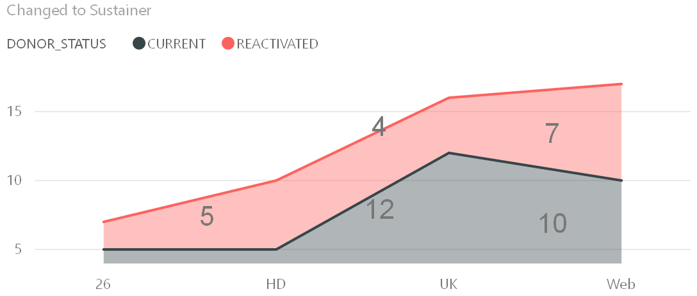
Majority of Donors Did not Change
Their Giving Style (1x vs Recurring)
Only 4 Changed from Recurring to 1x
Even those who did not change their giving style, the value of the gift increased by $11

